Slide 1
Item 16: Make const member functions thread safe
Scott Meyers - Effective Modern C++

Slide 2
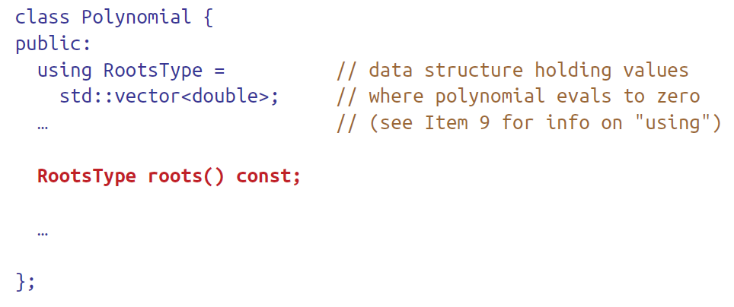
Consider a polynomials class contains a member function computes the root(s) of a polynomial:
Computing the roots of a polynomial can be expensive, so:
we don’t want to do it if we don’t have to.
if we do have to do it, we certainly don’t want to do it more than once.

Slide 3
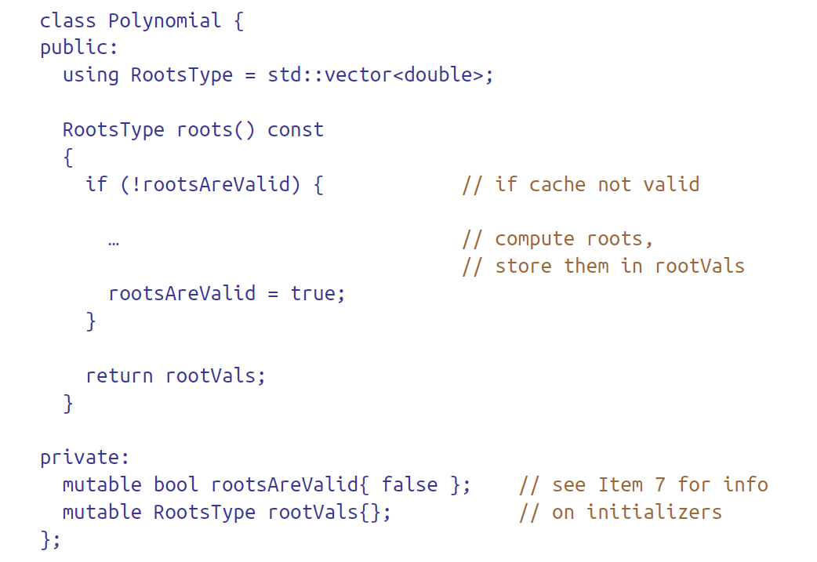

Slide 4
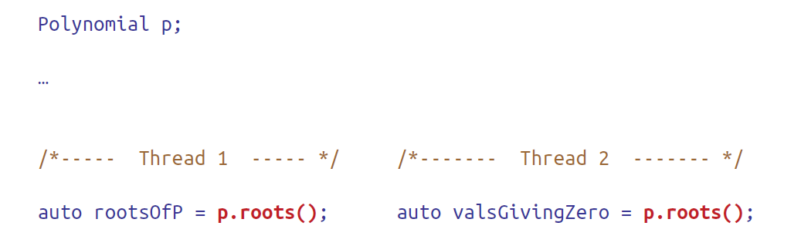
Imagine now that two threads simultaneously call roots on a Polynomial object:
roots is a const member function, and that means it represents a read operation. Having multiple threads perform a read operation without synchronization is safe.
In case of write operation, due to the lack of synchronization, the code has undefined behavior.
The problem is that roots is declared const, but it’s not thread safe.

Slide 5
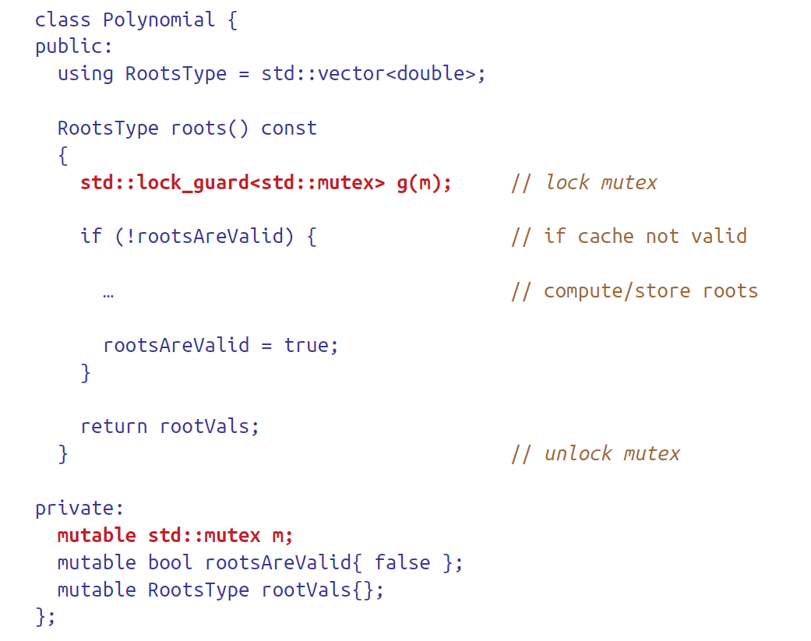

Slide 6
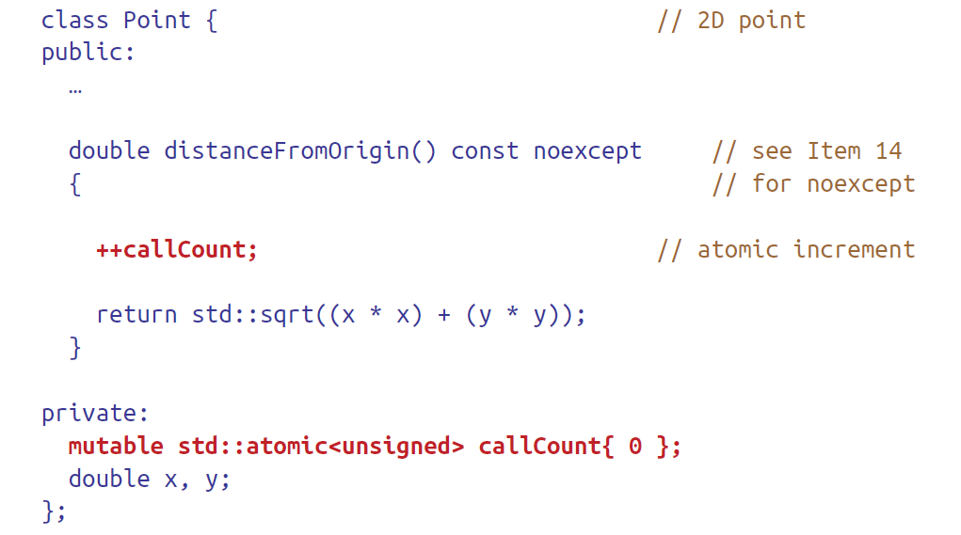
It’s worth noting that because std::mutex is a move-only type (i.e., a type that can be moved, but not copied), a side effect of adding m to Polynomial is that Polynomial loses the ability to be copied. It can still be moved, however.
In some situations, a mutex is overkill.
For example, if all you’re doing is counting how many times a member function is called, a std::atomic counter will often be a less expensive way to go.

Slide 7
Like std::mutexes, std::atomics are move-only types, so the existence of call Count in Point means that Point is also move-only.
Because operations on std::atomic variables are often less expensive than mutex acquisition and release, you may be tempted to lean on std::atomics more heavily than you should.
For example, in a class caching an expensive-to-compute int, you might try to use a pair of std::atomic variables instead of a mutex

Slide 8
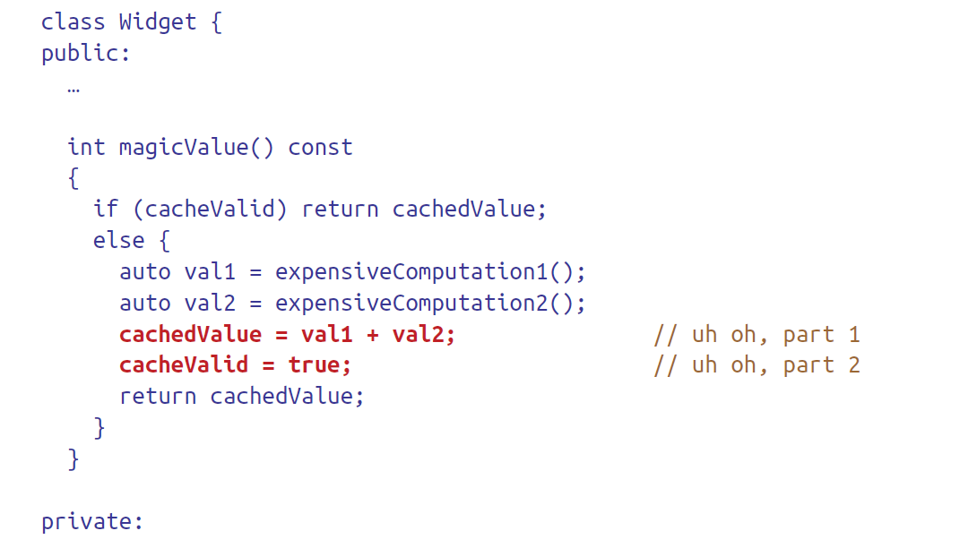
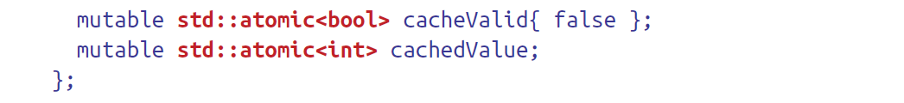
A thread calls Widget::magicValue, sees cacheValid as false, performs the two expensive computations, and assigns their sum to cachedValue.
At that point, a second thread calls Widget::magicValue, also sees cacheValid as false, and thus carries out the same expensive computations that the first thread has just finished. (This “second thread” may in fact be several other threads.)

Slide 9
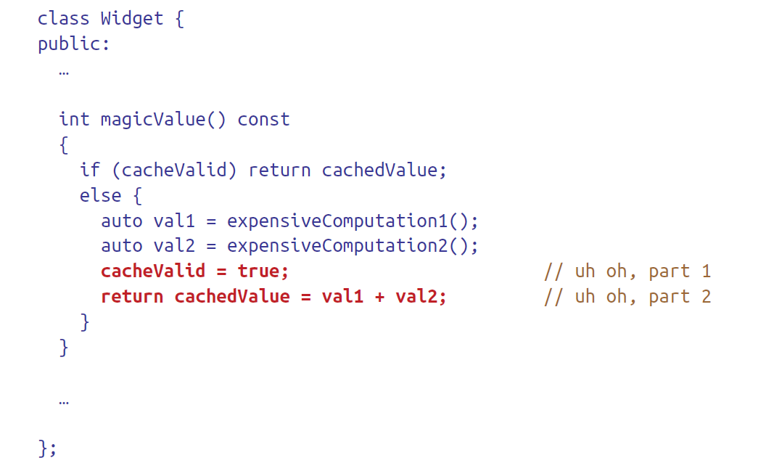
Imagine that cacheValid is false, and then:
One thread calls Widget::magicValue and executes through the point where cacheValid is set to true.
At that moment, a second thread calls Widget::magicValue and checks cacheValid. Seeing it true, the thread returns cachedValue, even though the first thread has not yet made an assignment to it. The returned value is therefore incorrect.

Slide 10
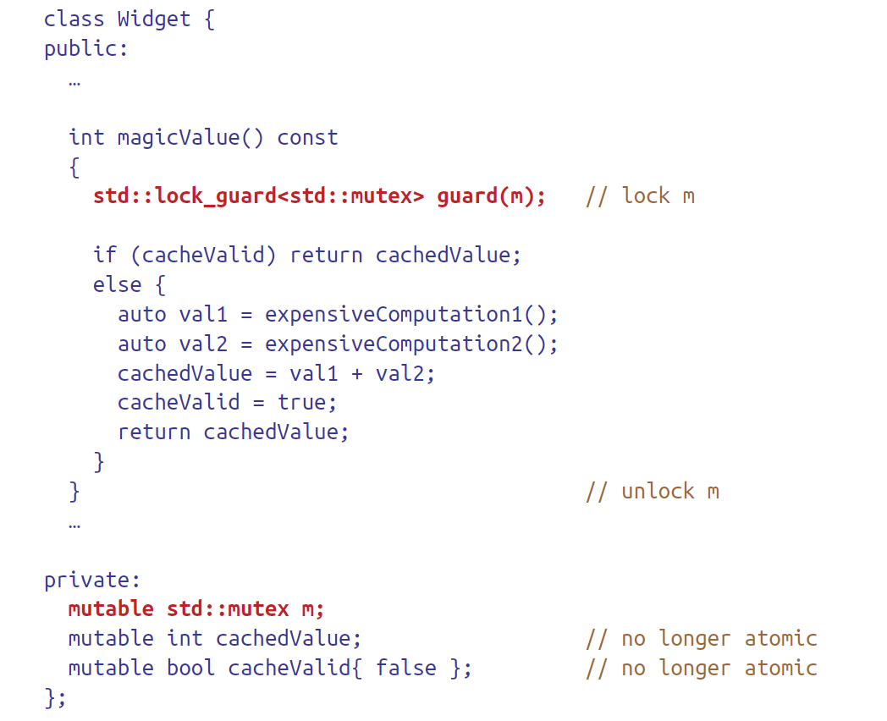
For a single variable or memory location requiring synchronization, use of a std::atomic is adequate.
but once you get to two or more variables or memory locations that require manipulation as a unit, you should reach for a mutex.

Slide 11


